Slide 1
Event Management System
A Database Management System Project
By Sudhanshu, Sindy, Tharuni, Marjan

Slide 2
Explanation of the problem
Event planning is a complex and time-consuming process, involving numerous stakeholders, tasks, and logistics.
Current methods of managing events often rely on manual processes or disparate systems, leading to inefficiencies and errors.
Clients face challenges in finding comprehensive solutions that address all their event planning needs in one platform.
Communication and coordination issues arise when managing multiple vendors, attendees, and stakeholders.

Slide 3
Importance of the Database for Solving the Problem:
A centralized event planning system will streamline processes by integrating key functionalities into one platform.
The database will automate repetitive tasks, facilitate communication, and provide real-time insights for decision making.
By offering a user-friendly interface, the database will enable collaboration between clients and event planners, enhancing overall efficiency.
With comprehensive data management capabilities, the database will address the challenges faced in event planning and improve the overall event management experience.

Slide 4

Requirements
Manage clients, tasks, and bookings
Track tasks progress and due dates
Organize events and manage attendance

Slide 5
Entity and Attribute Walkthrough
locations:
location_id, city_name, location_type, max_occupancy, locations_client_id
vendors:
vendor_id, vendor_first_name, vendor_last_name, vendor_contact_person, vendor_email, vendor_contact_number, vendors_invoice_id
invoices:
invoice_id, invoice_date_issued, invoice_status, invoices_vendor_id, invoices_client_id, invoices_payment_id
events:
event_id, event_date, event_type, event_guest_count, event_description, events_location_id, events_client_id, events_feedback_id
feedbacks:
feedback_id, feedback_rating, feedback_comment, feedbacks_client_id, feedbacks_event_id, feedbacks_staff_id

Slide 6
staff:
staff_id, staff_first_name, staff_last_name, staff_position, staff_email, staff_contact_number
clients:
client_id, client_name, client_contact_person_first_name, client_contact_person_last_name, client_type, client_email, client_contact_number, clients_location_id, clients_invoice_id, clients_event_id, clients_feedback_id, clients_payment_id, clients_pending_bookings_id
payments:
payment_id, payment_amount, payment_date, payment_method, payments_invoice_id, payments_client_id
tasks:
task_id, task
event_requests:
request_id, requesting_client_name, requesting_client_id, event_date, event_guest_count, request_approved_client_id, request_approved_date, request_event_description

Slide 7

Entity Relationships
One-to-Many Relationships:
Clients to Locations: Each client may be associated with multiple locations.
Clients to Invoices: Each client may have multiple invoices.
Locations to Events: Each location can host multiple events.
Vendors to Invoices: Each vendor may issue multiple invoices.
Events to Feedbacks: Each event can receive multiple feedbacks.
Events to Staff: Each event requires multiple staff members.
Staff to Tasks: Each staff member may have multiple tasks assigned.

Slide 8
Many-to-Many Relationships:
Locations to Vendors: Many locations can work with many vendors.
Clients to Vendors: Many clients may work with many vendors.
One-to-One Relationship:
Invoices to Payments: Each invoice corresponds to one payment.
Event Requests to Events: Each event request leads to one event being organized.
Event Requests to Clients: Each event request is associated with one client who requested it.
Event Requests to Approved Clients: Each event request is approved by one client.

Slide 9
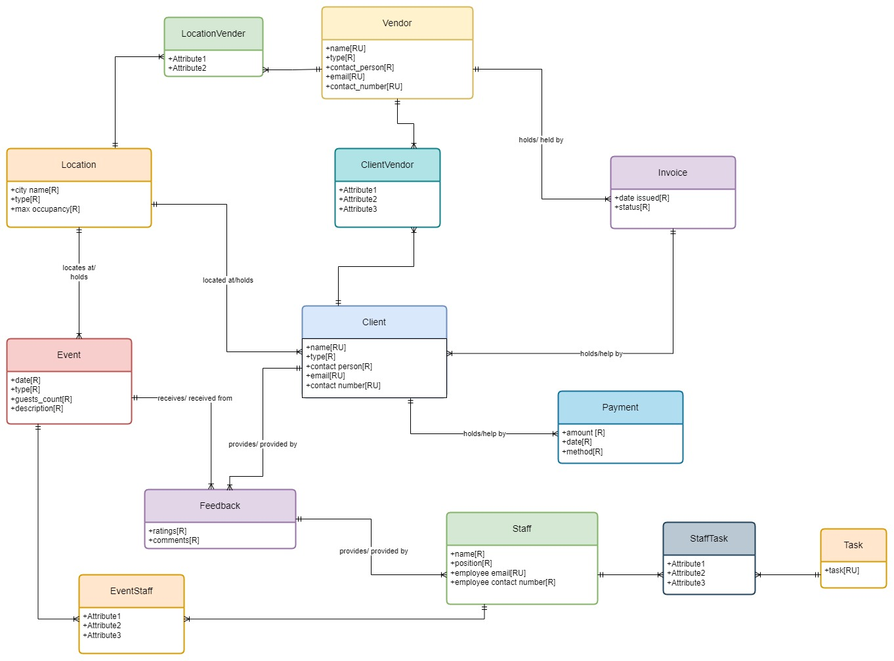
Conceptual Data Modelling

Slide 10
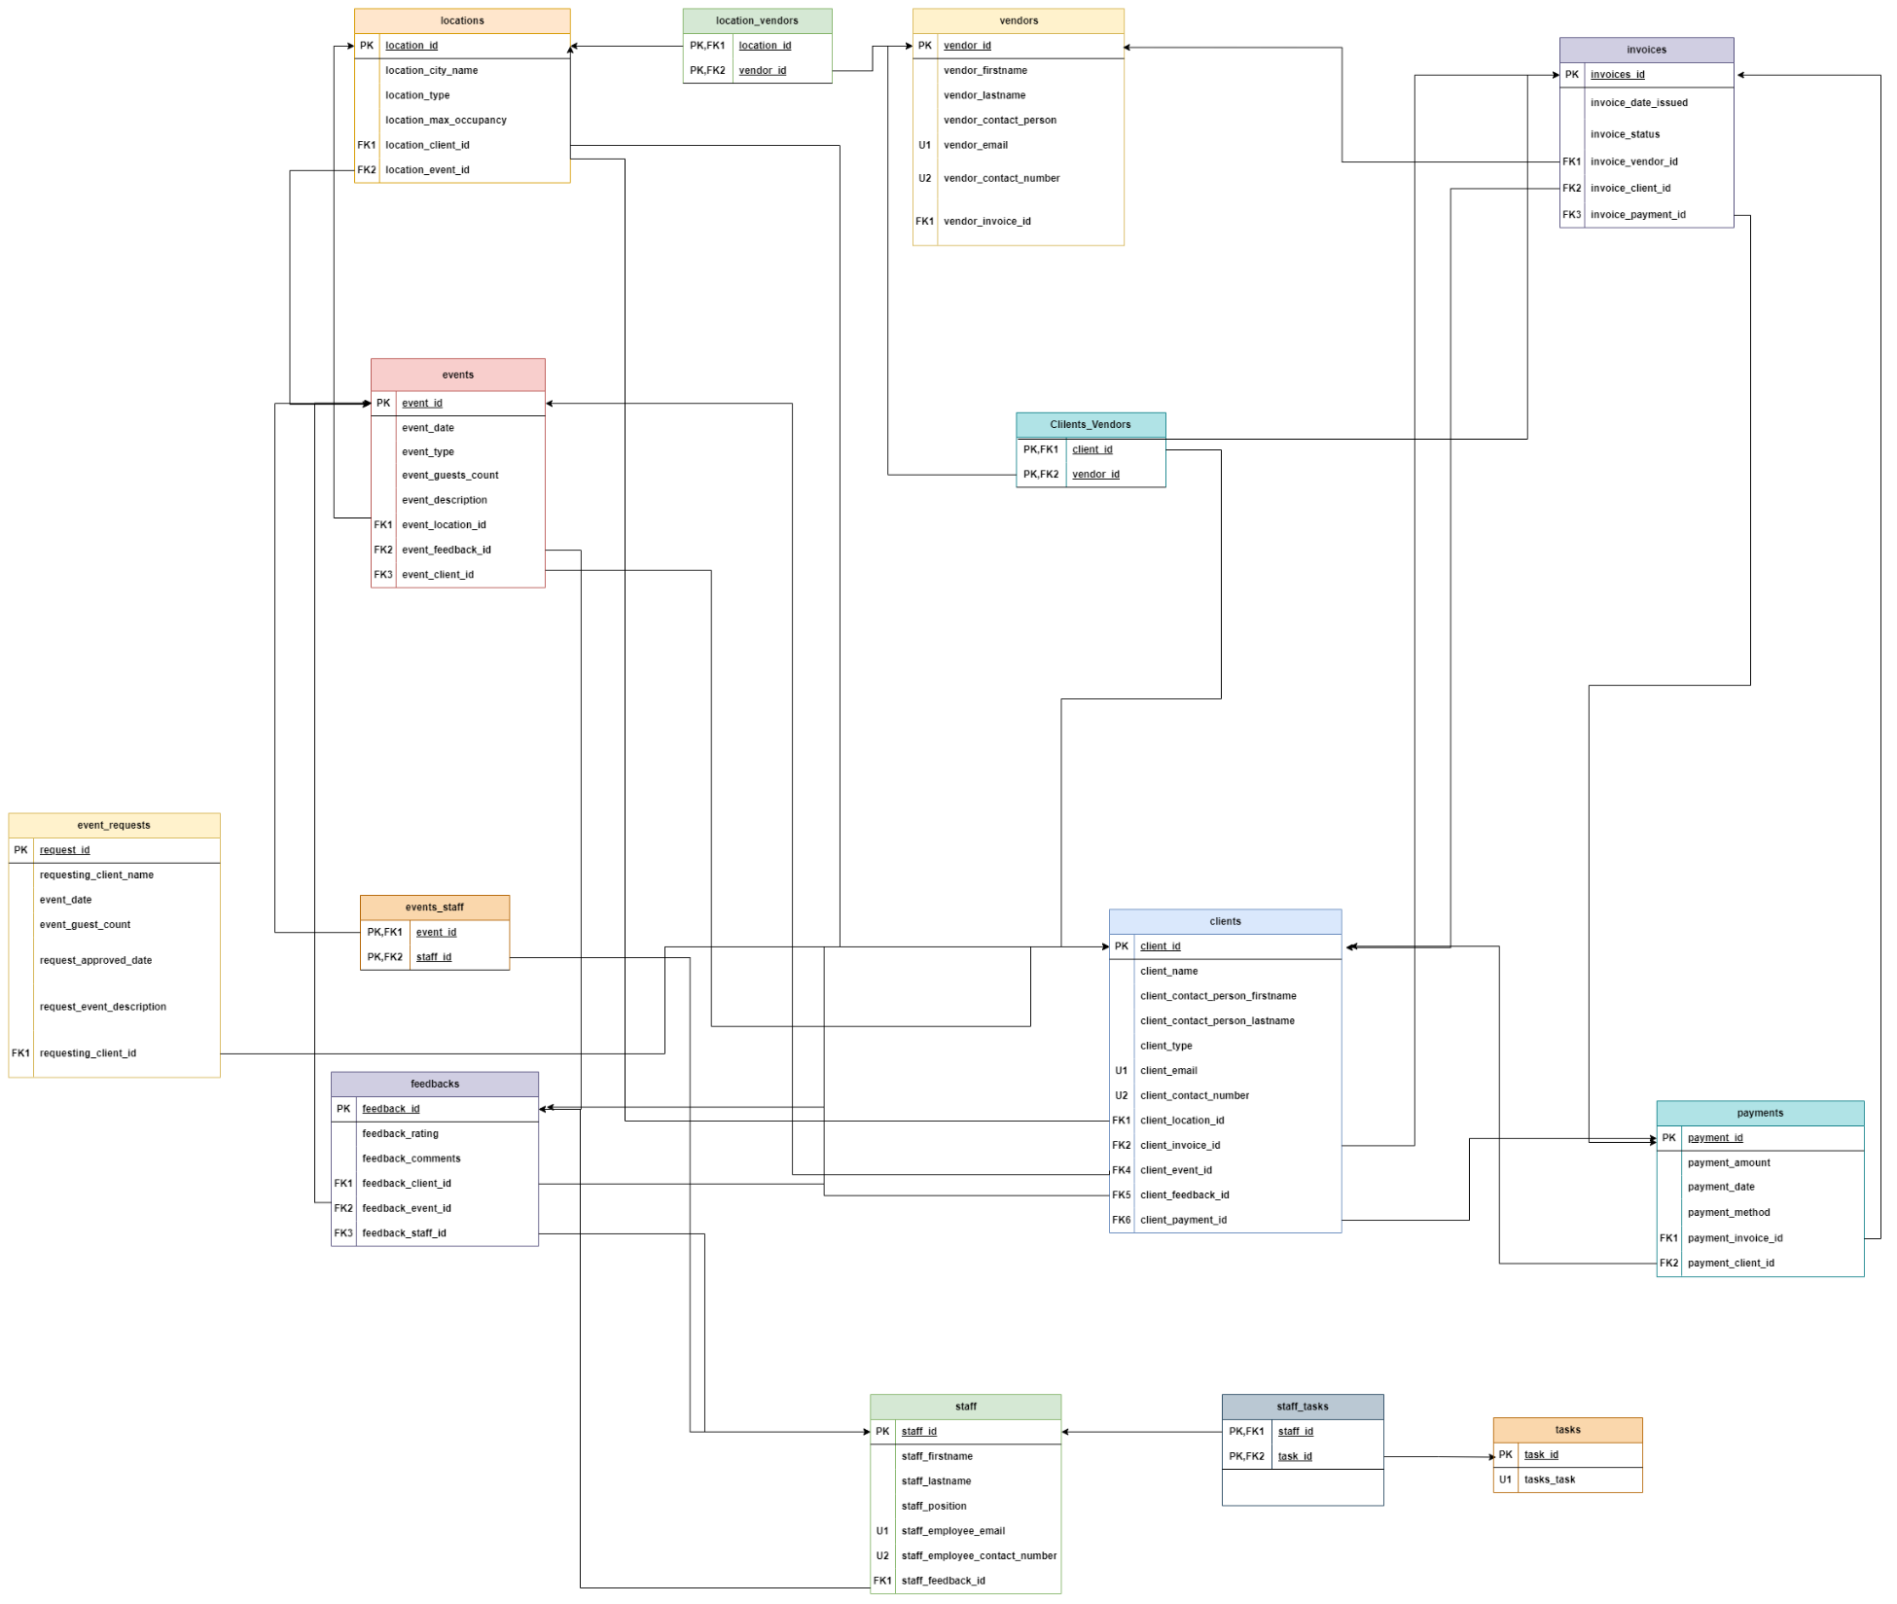
Logical Data Modelling

Slide 11
UP DOWN Script

Slide 12
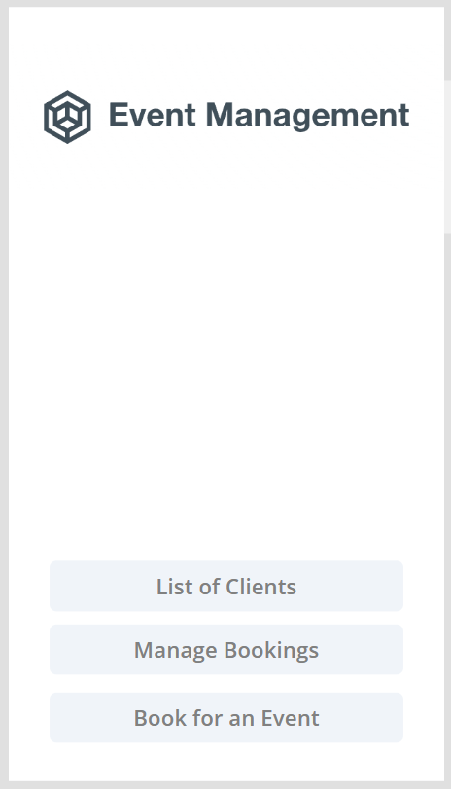
PowerApps

Slide 13
User Stories
As a Corporation I should be able to put up an Event request for my upcoming event.
I can mention the corporation's name, the guest count and description of the event.
As an Event manager I should be able to see requested Events our company can manage and Approve or delete those requests accordingly

Slide 14
Potential Enhancements
Enhance the payment system within our application.
Improve the workflow for management companies to manage staff, tasks, and feedback from both staff and clients.
Implement vendor selection and management features accessible to both management and clients

Slide 15
Team Log
Ideas and Business Problems: Sindy, Tharuni, Sudhanshu, Marjan
Conceptual and Logical Data Models: Sindy and Tharuni
Up Down Script: Sudhanshu and Marjan
App Development: Sudhanshu
Presentation: Tharuni and Marjan.

Slide 16
Individual Reviews/Feedback

